Slide 1
Recursion
100058 - Anita Kivindyo
100060 - Maria Ogamba
100036 - Eric Burugu
101426 - Naomi Mwangi

Slide 2
What is Recursion?
Recursion attempts to solve a "big" problem by solving smaller versions of the problem, then using the solutions to the smaller versions of the problem to solve the big problem.
This is more of a divide-and-conquer method. For example, consider merge sorting. The idea behind merge sorting is to divide an array into two halves, and sort each half. Then, you "merge" the two sorted halves to sort the entire list.

Slide 3
Recursion
Recursive function - A procedure or subroutine that references itself.
There are two main types of recursion :
Direct Recursion.
Indirect Recursion.

Slide 4
Direct Recursion
In direct recursion, the procedure calls itself.
There are four types of direct recursion
Tail recursion - If a recursive function calling itself and that recursive call is the last statement in the function then it’s known as Tail Recursion. After that call the recursive procedure performs nothing.

Slide 5
Direct Recursion
(types)
Head Recursion - If a recursive function calling itself and that recursive call is the first statement in the function then it’s known as Head Recursion. There is no statement or operation before the call. All operations are done at returning times.

Slide 6
Direct Recursion
(types)
Linear Recursion - If a recursive function calling itself for one time then its known as linear recursion.
Tree Recursion - If a recursive function is calling itself for more than one time.

Slide 7
Recursion Example (Direct)
section .text
factorial:
cmp ebx, 1 ; if param = 1, return 1
dec ebx
jnz factorial
mov eax, 1
ret

Slide 8
Indirect Recursion
A procedure may initiate a sequence of calls that eventually results in calling the procedure itself.
For example, first procedure calls the second procedure, and in turn, the second procedure is used to call the first procedure.

Slide 9
Recursion Example (Indirect)
section .text
factorial:
cmp ebx, 1 ; if param = 1, return 1
jnz factorial1
mov eax, 1
ret
factorial1: ; else
push ebx ; save param
dec ebx ; recursive call with param -1
call factorial ; after this, factorial(param -1) in eax
pop ebx ; restore call parameter of this round
imul eax, ebx ; retval = param * factorial(param - 1)
ret ; return retval

Slide 10
Registers and calls used in recursion -32bit
Dec ebx- Decrements the value in register ebx by 1 (n-1)
Imul eax,ebx-Signed integer multiplication
Call factorial -push the address to the next instruction then jump to factorial
Pop ebx- restores the parameter of that round back to register ebx
Cmp ebx- compares the value in register ebx to the set condition (n=>1?)
Jnz factorial1- If not go to the recursive call (factorial1)
Mov eax,1- otherwise return 1
Ret - Transfers control to the return address located on the stack.
Push ebx- Pushes the parameter and saves it to the stack

Slide 11
Conditions for Recursion
Example
If (n==0){
Return 1
} else {
Return n*fact(n-1)
}
There should be a condition that terminates the recursion i.e If(n==0)
There should be a a part of code to do the task i.e n*fact(n-1)
In assembly the return address should be included.

Slide 12
How recursion works
Each active procedure maintains an activation record, which is stored on the stack.
The activation record contains the arguments, return address and local variables.
The activation record is created when a procedure is invoked, and disappears when the procedure is terminated.

Slide 13
How recursion works
The number of activation records, hence the amount of stack space required to run the program, depends on the depth of recursion.
In factorial, each call to the factorial function creates an activation record.
Factorial is an example of direct recursion.
The figure in the next slide shows the activation records for factorial(3).

Slide 14
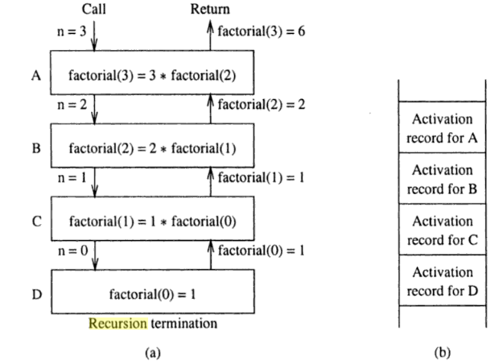
How recursion works - factorial

Slide 15
Other examples that use recursion
Fibonacci number computation
Quicksort Algorithm
Binary search algorithm

Slide 16
Limitations of recursion
Inefficiency
- Recursion induces more overheads to invoke and return from procedure calls. To compute n!, we need to call the factorial function about n times
- It could also introduce duplicate computation:
fib (5) = fib(4) + fib (3)
- Recursive procedure computes fib(3) twice, fib(2) twice, and so on.

Slide 17
Limitations of recursion
2. Increased memory requirement
- The demand for stack memory can be excessive for large n in n! Because the depth of the stack depends on the depth of recursion.
- The limit of available memory may make recursion unusable in some cases.

Slide 18
Questions
What is an activation record?
What are the limitations of recursion?
Where is recursion used?

